Slide 1
Semantic Nets

Slide 2

Semantic Network
A semantic network is often used as a form of knowledge representation.
A semantic network or net is a graph structure for representing knowledge in patterns of interconnected nodes and arcs.
It is a directed graph consisting of vertices which represent concepts and edges which represent semantic relations between the concepts.
Semantic nets at the time of its origin were used mainly in understanding natural language, where the semantics (meaning) of the associated words in a sentence was extracted by employing such nets.
A semantic net consists of two elementary tuples: events denoted by nodes and relationship between events, denoted by links / arcs.
A simple semantic net above describes a binary predicate: Likes (X, Y)

Slide 3
Semantic Network
Boxed nodes/ Oval nodes -- objects and values of attributes of objects.
Values can be objects with attributes and so on.
Arrows -- point from object to its value.
This structure is known as a slot and filler structure, semantic network or a collection of frames.
The algorithm to retrieve a value for an attribute of an instance object:
1. Find the object in the knowledge base
2. If there is a value for the attribute report it
3. Otherwise look for a value of instance if none fail
4. Otherwise go to that node and find a value for the attribute and then report it
5. Otherwise search through using isa until a value is found for the attribute.

Slide 4
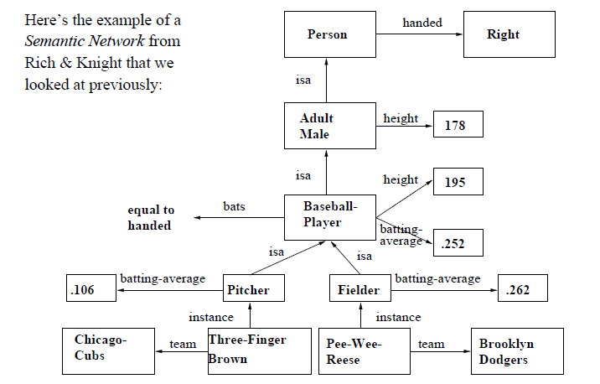
A Simple Semantic Network

Slide 5
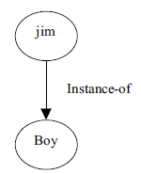
Semantic Network contd..
consider the unary predicate: boy (jim). This can be represented by a binary predicate Instance-of (jim, Boy) as follows:
predicates having more than two arguments can also be represented by semantic nets
For example, consider the ternary predicate: Gave (john, the-beggar, 10$)

Slide 6
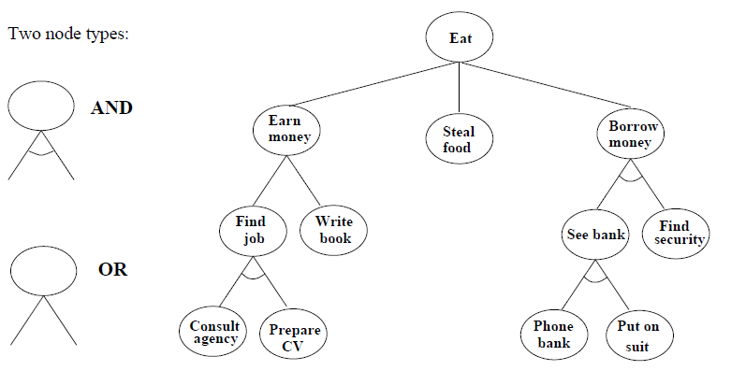
AND/ OR Trees

Slide 7
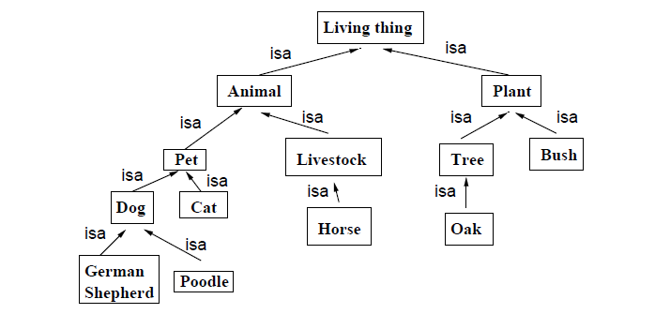
An IS-A Hierarchy
In set-theory terms, is-a corresponds to the sub-set relation ⊆, and instance corresponds to the membership relation ∈.

Slide 8
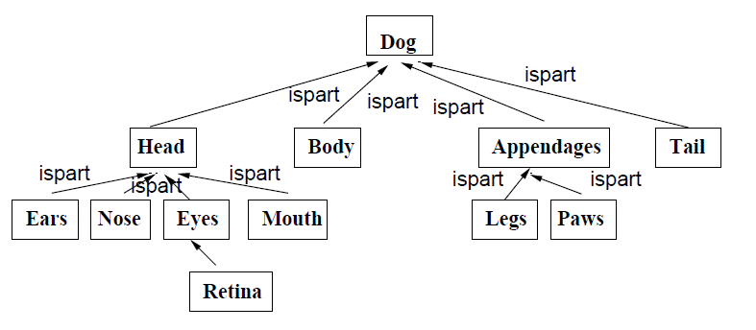
An IS-PART Hierarchy

Slide 9
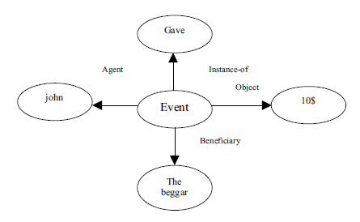
Semantic Network contd..
It is thus clear that a predicate of arity >2 can be represented by a number of predicates, each of arity 2
Agent (john, event)
Beneficiary (the-beggar, event)
Object (10$, event)
Instance-of (give, event).

Slide 10
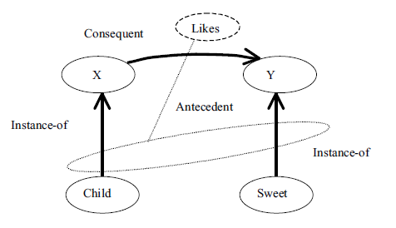
Example
Instance-of (X, Child) ∧ Instance-of (Y, sweet) → Likes (X, Y)
For example, suppose we like to represent FOPL based sentence:
∀X ∃Y (Child (X) ∧ Sweet(Y) → Likes(X,Y))
This can be transformed into the following forms of binary predicates:
∀X ∃Y (Instance-of (X, child) ∧ Instance-of (Y, sweet) → Likes (X, Y)).
To represent the given clause by an alternative form of semantic nets, we, for example, first express it in CNF.
The CNF of the above sentence is
( ￢Instance-of(X, child) ∨ ￢Instance-of (Y, sweet) ∨ likes(X, Y)).

Slide 11
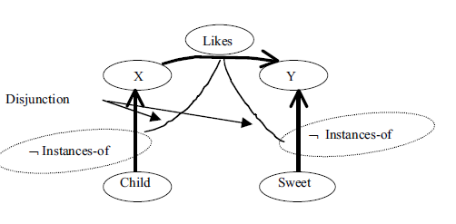
Example

Slide 12
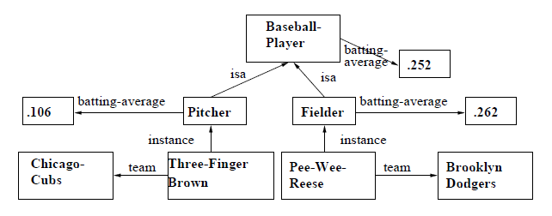
Intersection Search
One of the earliest ways that semantic networks were used was to find relationships between objects by spreading activation from each of two nodes and seeing where the activations met.
This process is called intersection search
Question: “What is the relation between Chicago cubs and Brooklyn Dodgers?”

Slide 13
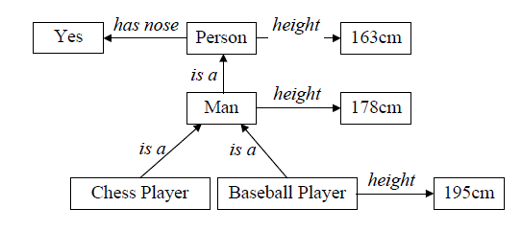
Inheritance and Defaults
Two important features of semantic networks are the ideas of default (or typical) values and inheritance.
We can assign expected/default values of parameters (e.g. height, has nose) and inherit them from higher up the hierarchy.
This is more efficient than listing all the details at each level.
We can also over-ride the defaults
For example, baseball players are taller than average, so their default height over-rides the default height for men.

Slide 14
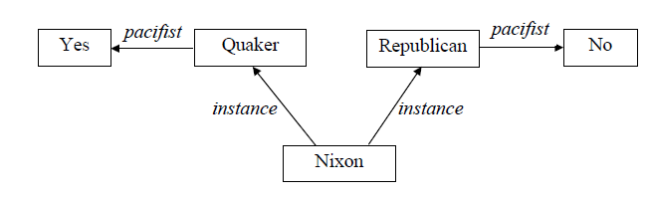
Multiple Inheritance
With simple trees, inheritance is straight-forward
However, when multiple inheritance is allowed, problems can occur.
Question: “Is Nixon a pacifist?”
Conflicts like this are common is the real world.
In practice, we aim to build semantic networks in which all such conflicts are either over-ridden, or resolved appropriately
The resulting conflict can be resolved only if additional information stating a preference to one of the conflicting inferences is provided.

Slide 15
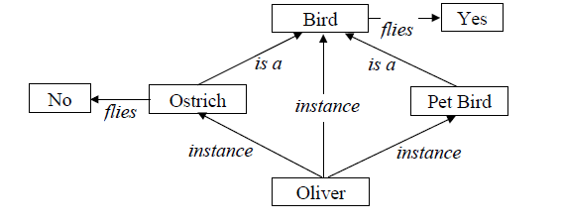
Tangled Hierarchies
Question: “Can Oliver fly?”
A better solution than having a specific “flies no” for all individual instances of an ostrich, would be to have an algorithm for traversing the algorithm which guarantees that specific knowledge will always dominate over general knowledge.

Slide 16
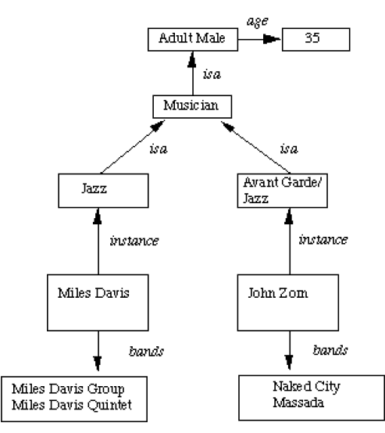
Property Inheritance
We extend the base more by allowing inference mechanisms:
      elements inherit values from being members of a class.
      data must be organised into a hierarchy of classes.

Slide 17
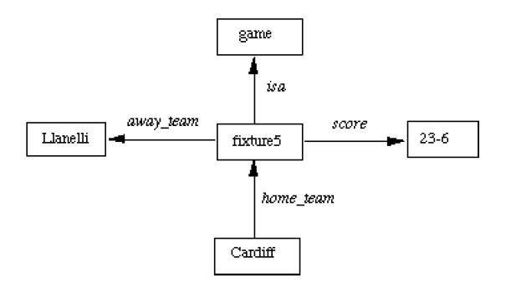
Semantic Network
How we can have more than 2 place predicates in semantic nets? E.g. score(Cardiff, Llanelli, 23-6)

Slide 18
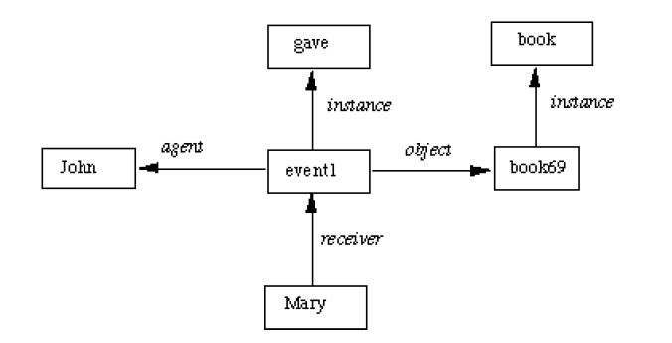
Semantic Network
consider the sentence: John gave Mary the book

Slide 19
Inference in a Semantic Network
Intersection search -- the notion that spreading activation out of two nodes and finding their intersection finds relationships among objects.
Inheritance -- the isa and instance representation provide a mechanism to implement this
Example: Emus are birds, Typically birds fly and have wings, Emus run.

Slide 20
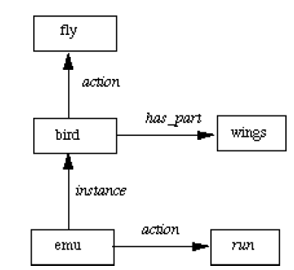
Example

Slide 21
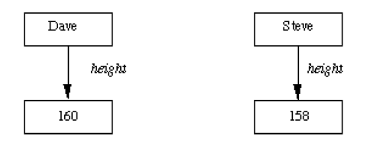
Inference in a Semantic Network
Consider the example where the height of two people is depicted and we also wish to compare them.

Slide 22
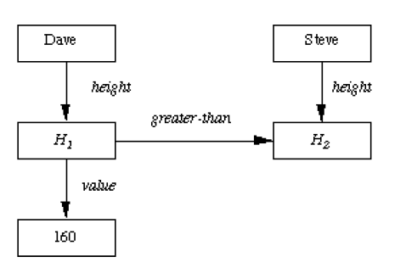
Solution

Slide 23
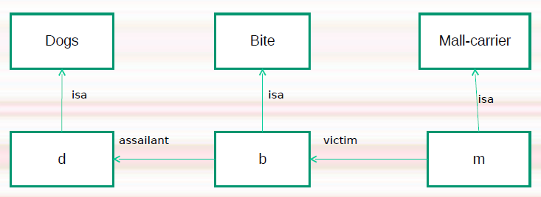
Example
The dog bites the mail-carrier
Every dog has bitten a mail carrier

